Slide 1

Modern Era of Reverse Engineering
A Demonstration Collection by Melih Tolga Sahin

Slide 2

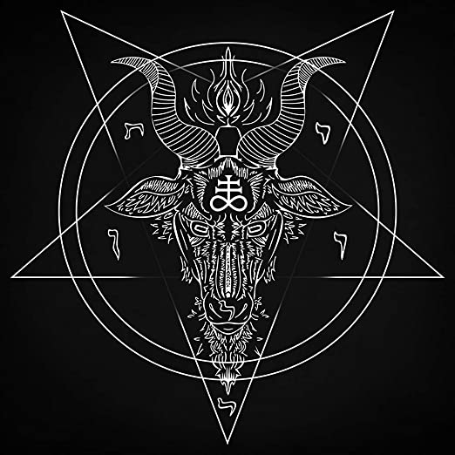

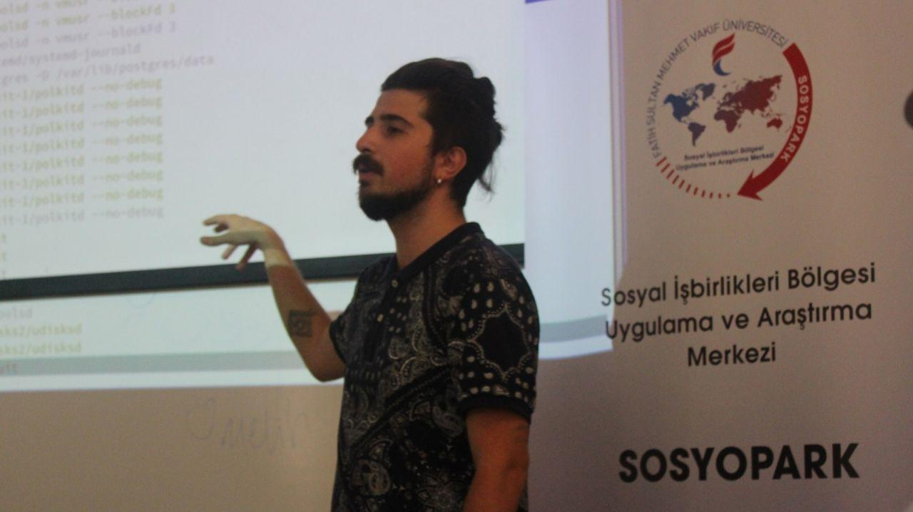
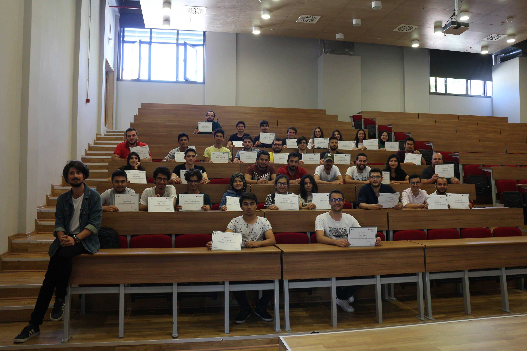

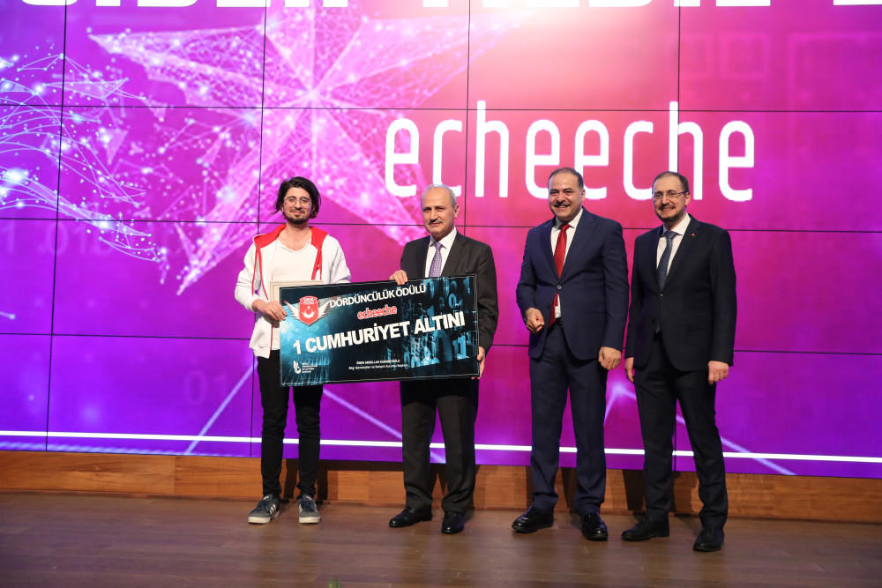

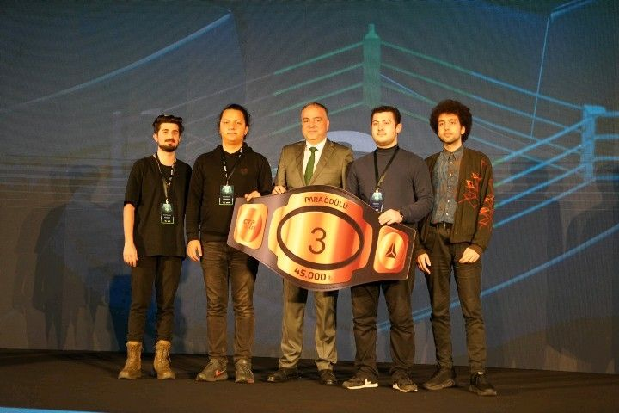
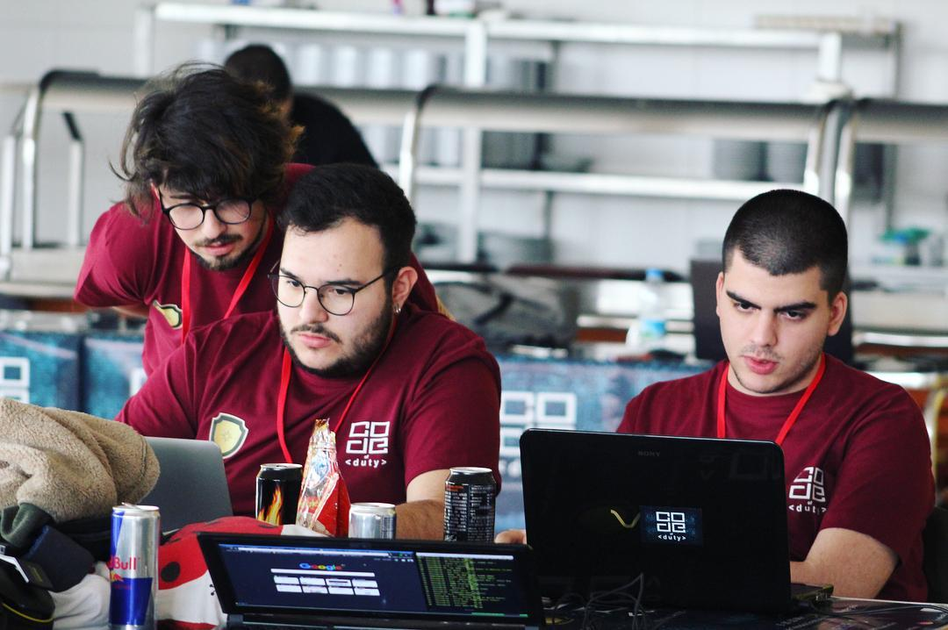
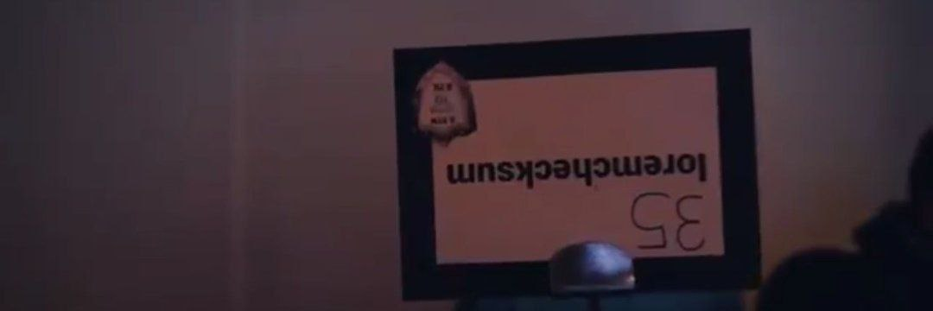
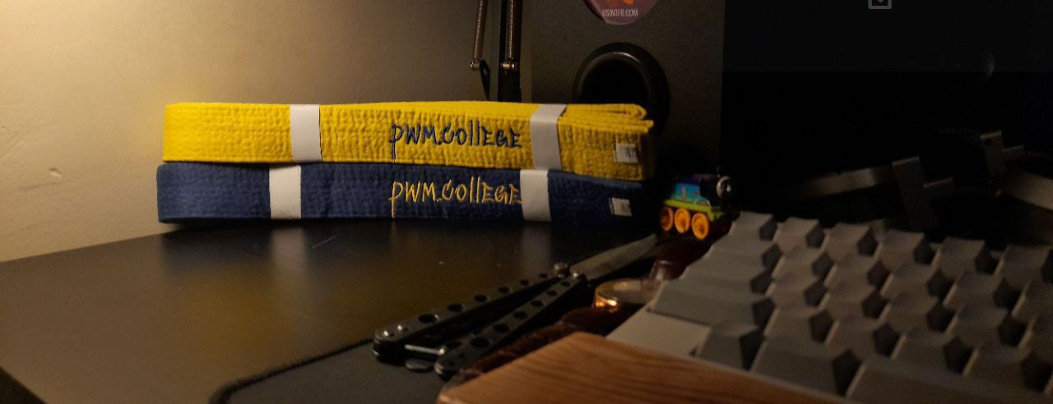
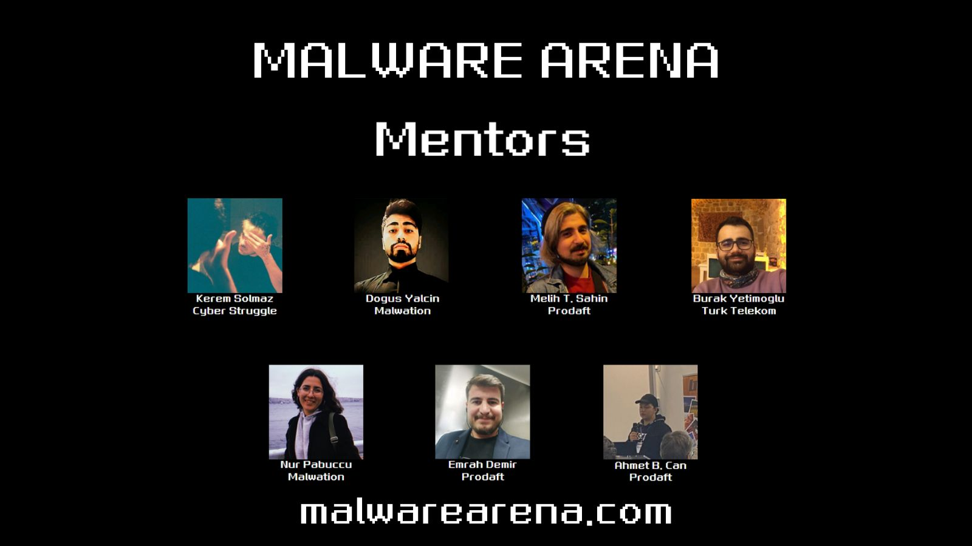
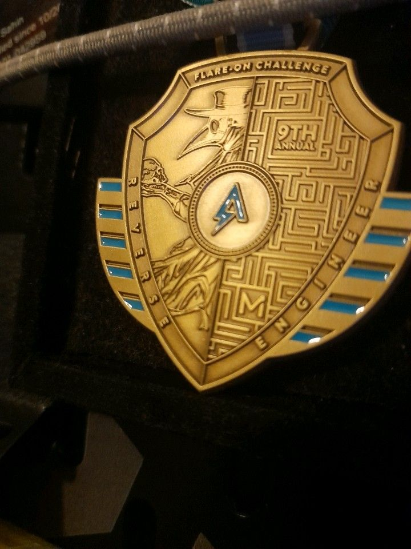
$ whoami
Currently: DevSecOps Engineer at
Author @ devilinside.me, tmp0ut.sh
Exec. @ TTMO
Worked as :
Penetration Tester, Reverse Engineer, Threat Intelligence Analyst, Vulnerability Researcher, Application Security Engineer, Software Developer
Public CVEs: CVE-2024-26343, CVE-2023-1605

Slide 3

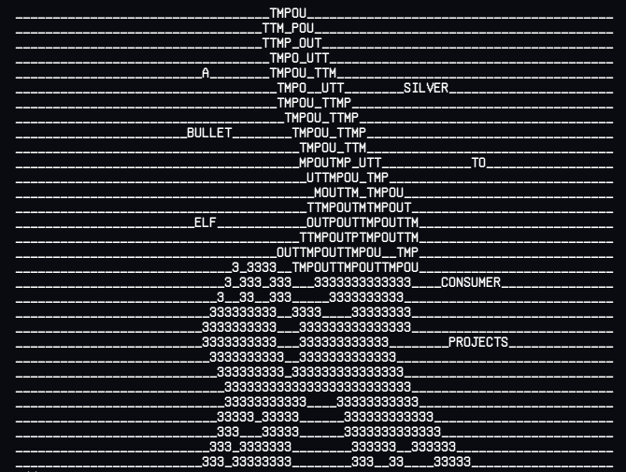
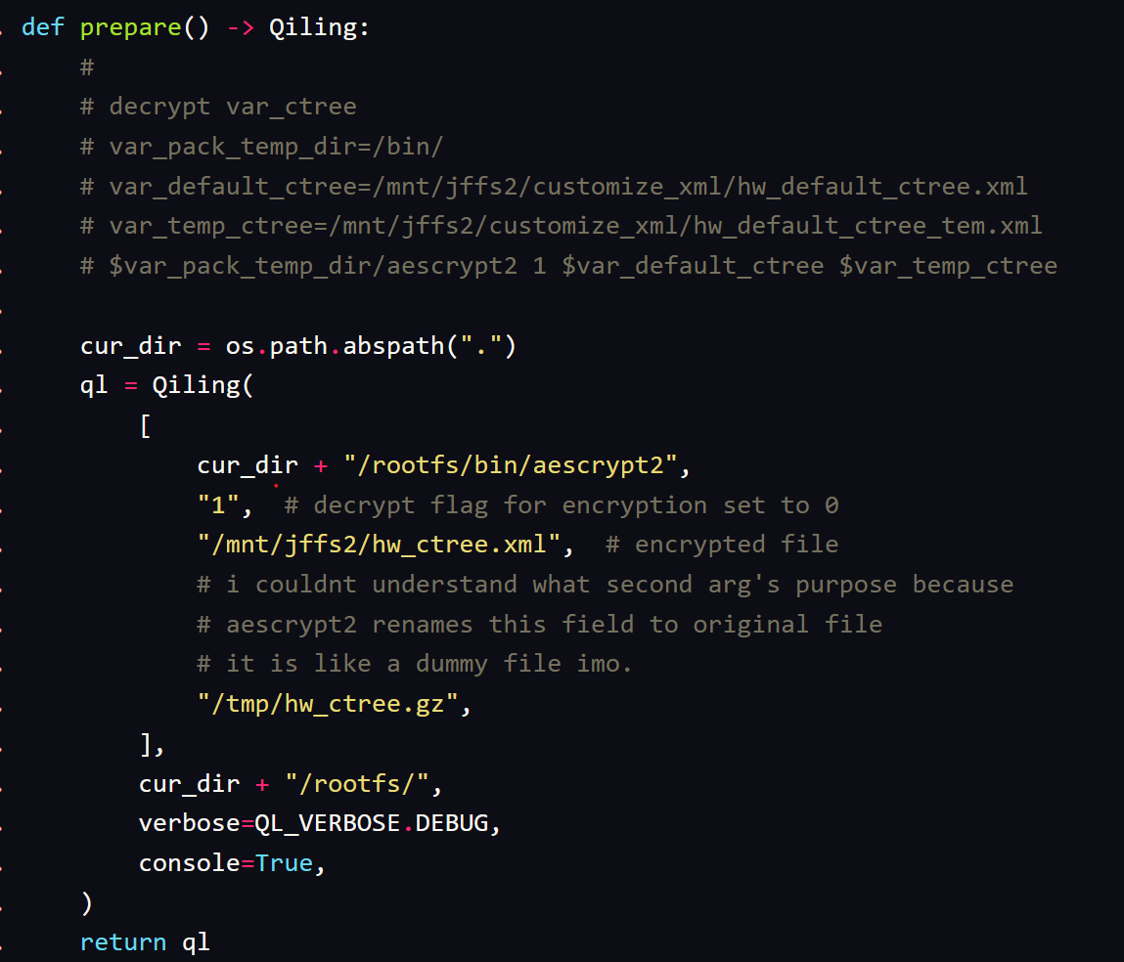
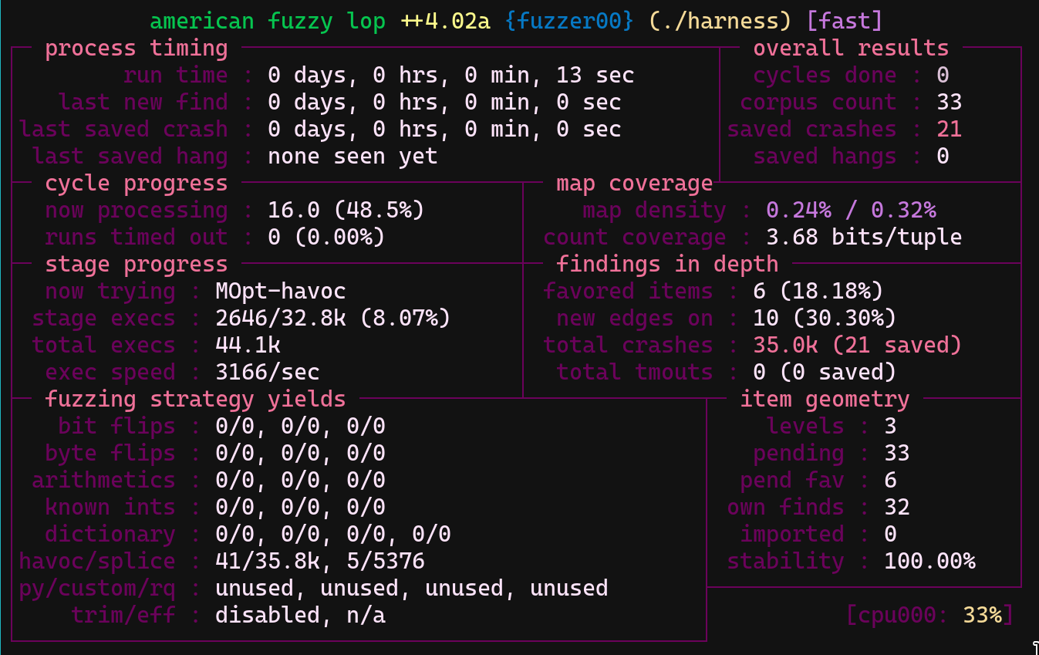
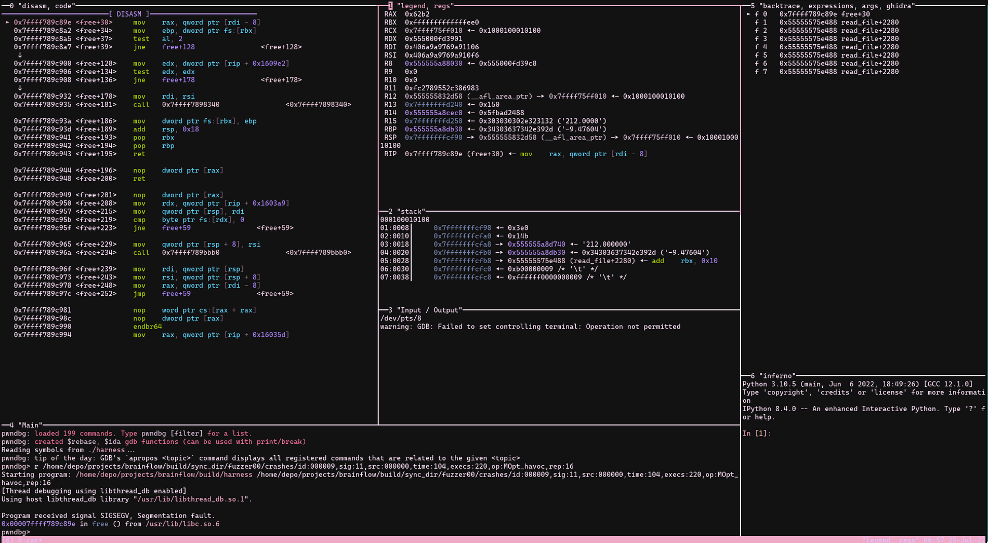
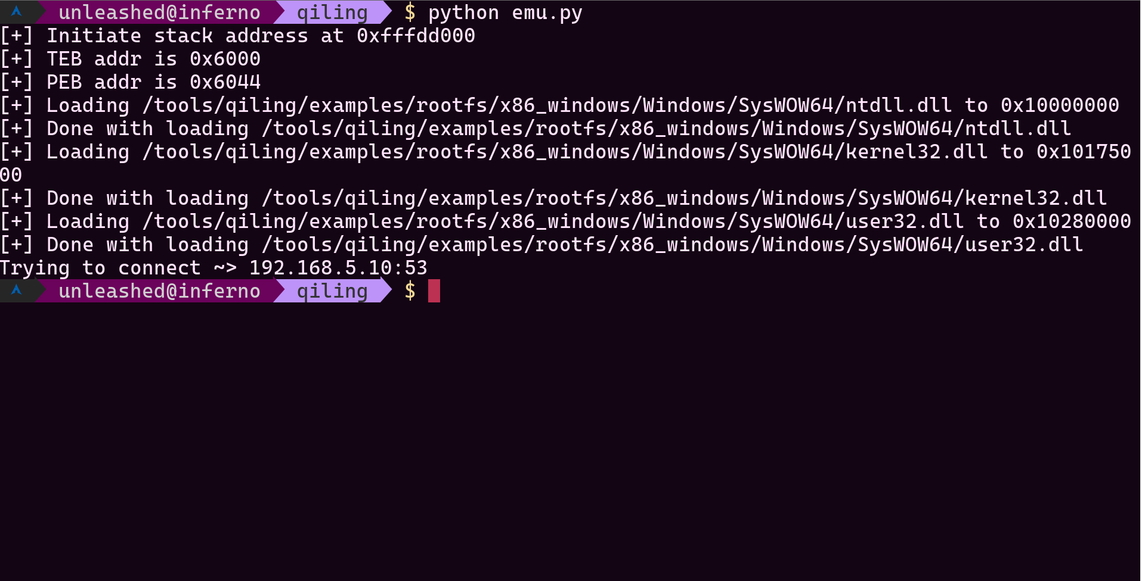
$ Contents
Quick glimpse of daily routines of RE
Tool-Assisted Superplay (TAS)
TAS Example 1:
CVE-2015-2797 experience without an Airties Modem
TAS Example 2:
Emulating Huawei OptiXstar’s Encryption binary without a real Huawei ONT
TAS Example 3:
A dynamic analysis of a msfvenom payload
Fuzzing
Fuzzing Campaign Example 1:
A simple harness for a EEG, EMG, ECG biosensors library.
Fuzzing Campaign Example 2:
Fuzzing ELF Parsers with a custom mutator
Fuzzing Campaign Example 3:
Fuzzing complex Instant Messaging Applications’ data structures via Structure-Aware Fuzzing

Slide 4
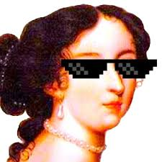
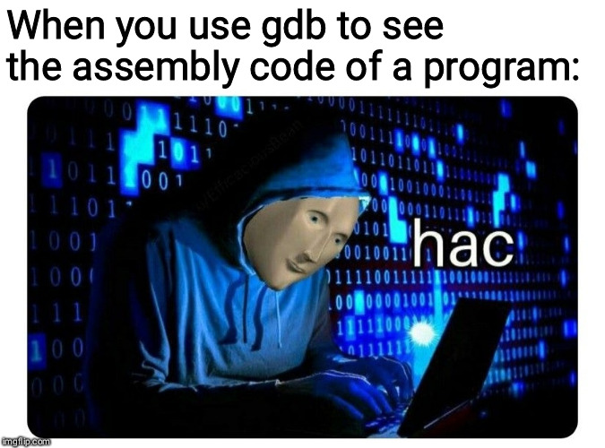
Daily RE Tasks (Almost)
Reading Assembly Codes
Reading Source Codes (If it is available)
Control-flow unflattening
Decrypt actual payloads
Finding Interesting Functions
Dealing with VMs (and other protections)
Debugging the program to find out Input Flow
Finding out the accepted format of user input
Fuzzing
Writing an actual exploit for the target

Slide 5
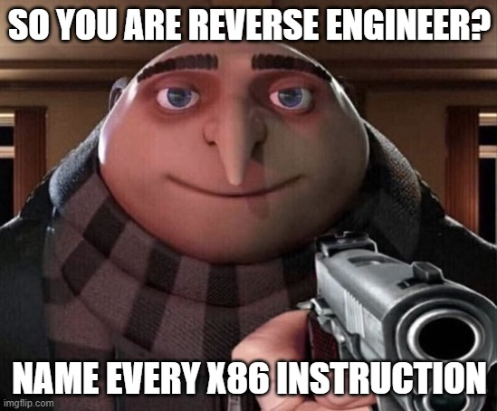
Daily RE Tasks (Mentioned)
Reading Assembly Codes
Reading Source Codes (If it is available)
Control-flow unflattening
Decrypt actual payloads
Finding Interesting Functions
Dealing with VMs (and other protections)
Debugging the program to find out Input Flow
Finding out the accepted format of user input
Fuzzing
Writing an actual exploit for the target

Slide 6
Reverse Engineer Issues
i have crippling depression
Psychologically exhausting (optional)
Time consuming
If there is no purchased tool already, requires more manual work
Not being able to automate routines

Slide 7
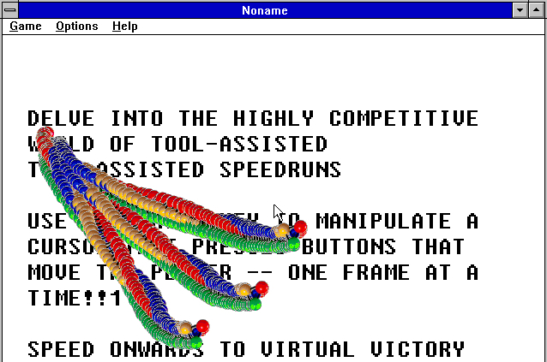

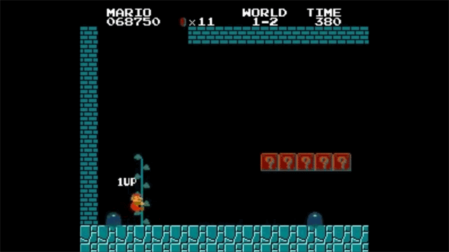
Tool-Assisted Superplay (TAS)
CELESTE (2018)
Mario Bros. (1983)

Slide 8
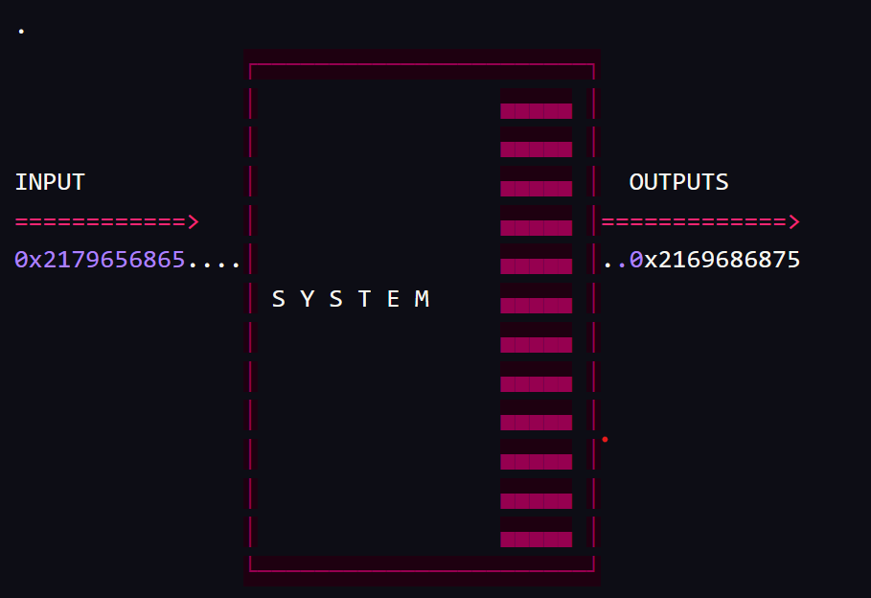
Super Simplification
Common ground between TAS Runners and Vulnerability Researchers

Slide 9
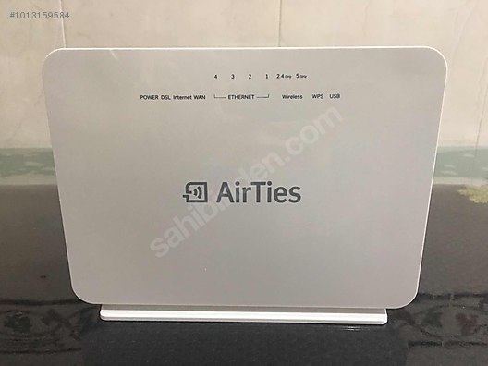
TAS Example: CVE-2015-2797
Stack-based buffer overflow in AirTies Air 6372, 5760, 5750, 5650TT, 5453, 5444TT, 5443, 5442, 5343, 5342, 5341, and 5021 DSL modems with firmware 1.0.2.0 and earlier allows remote attackers to execute arbitrary code via a long string in the redirect parameter to cgi-bin/login.

Slide 10
TAS Example: CVE-2015-2797
This is an Airties Air 5750

Slide 11
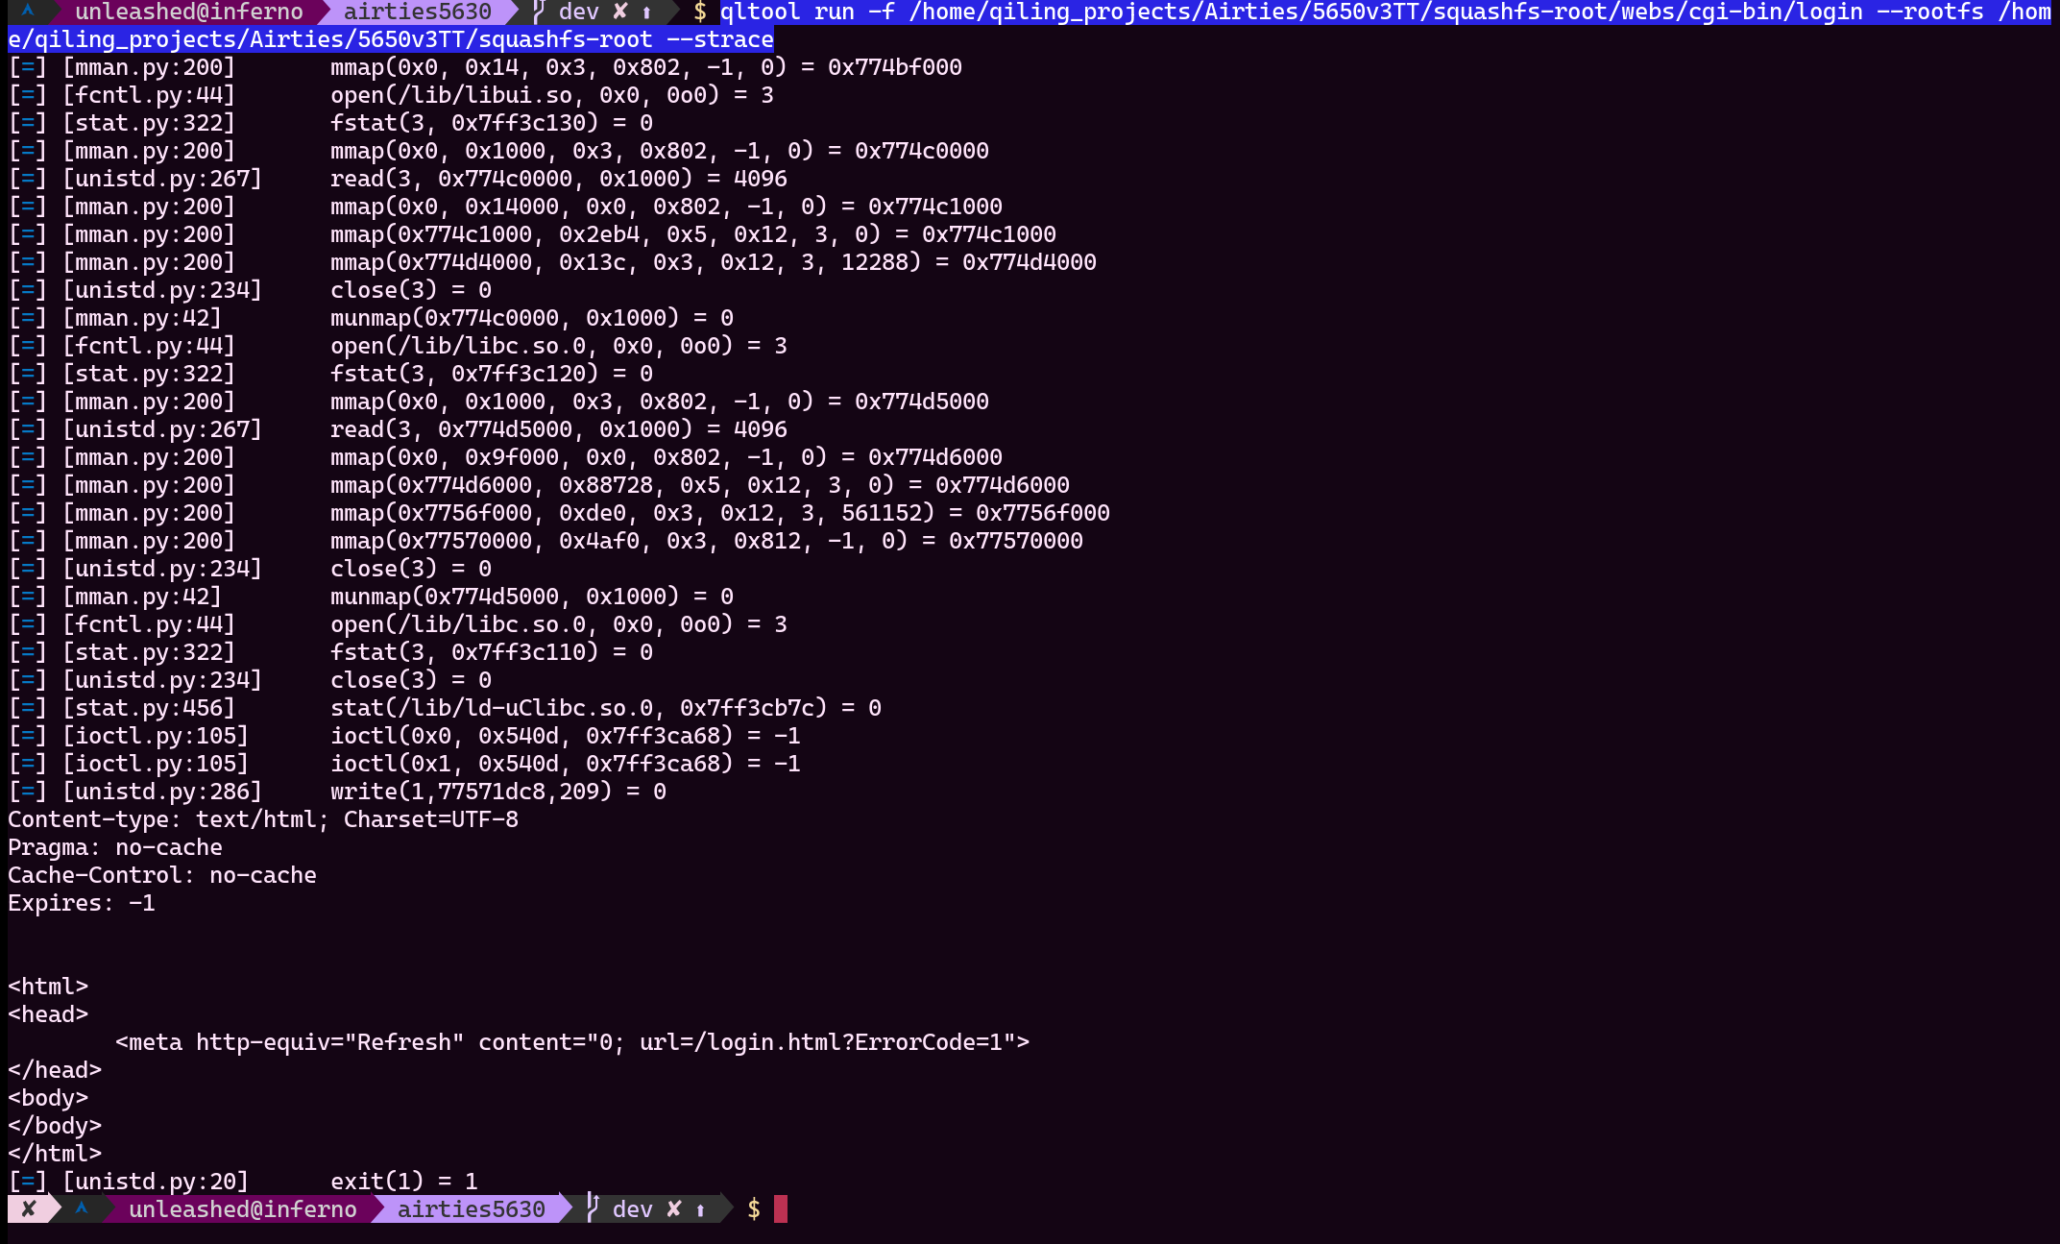
TAS Example: CVE-2015-2797
qltool is in tool-chain in Qiling Binary Framework

Slide 12
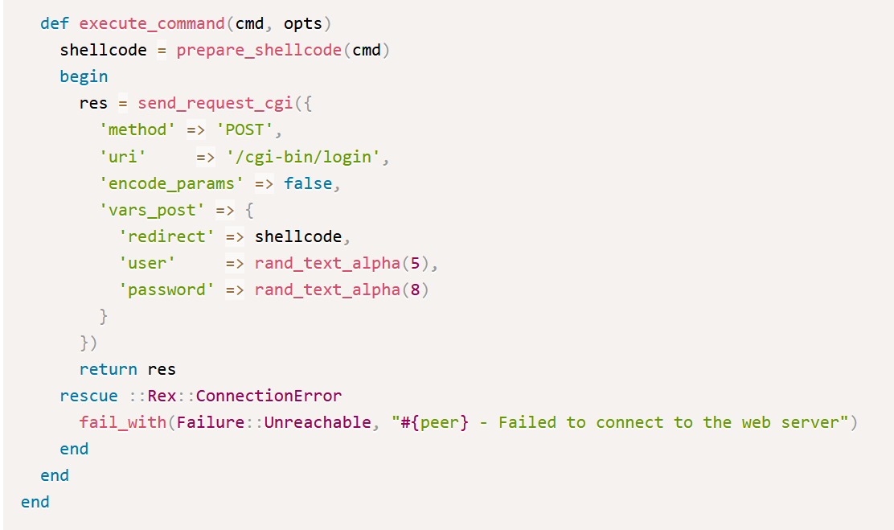
TAS Example: CVE-2015-2797
CVE-2015-2797 Metasploit Module snippet

Slide 13
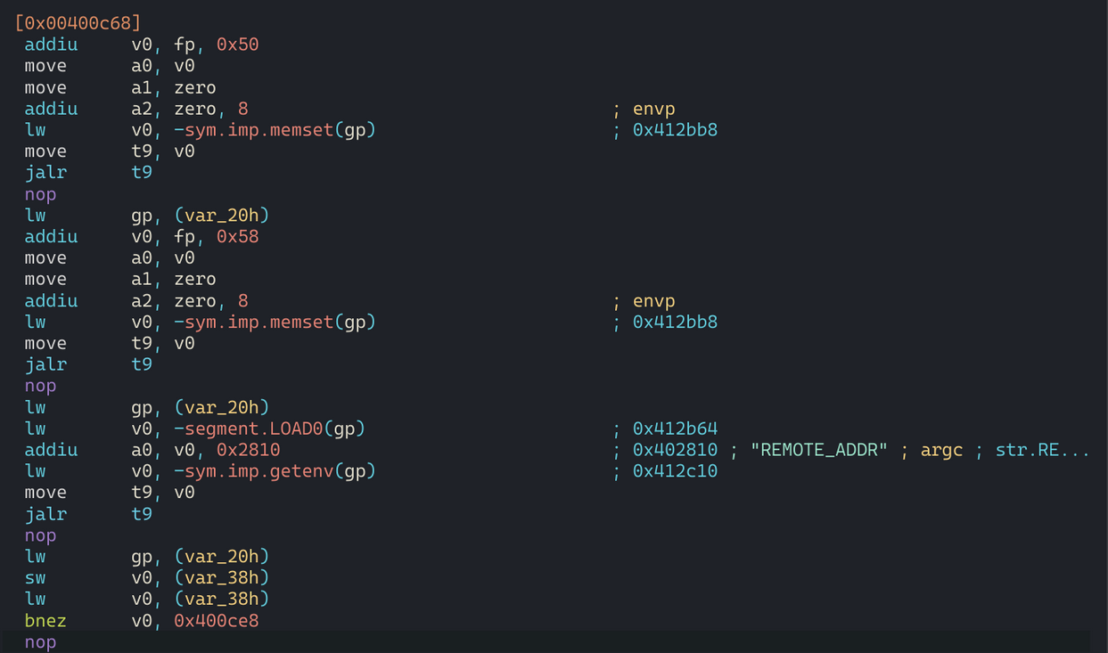
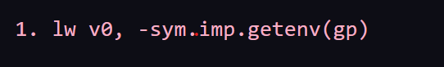
TAS Example: CVE-2015-2797
cgi-bin/login binary analysis with Cutter

Slide 14
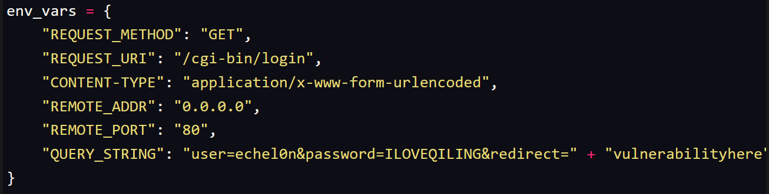
TAS Example: CVE-2015-2797
Writing our custom emulation script

Slide 15
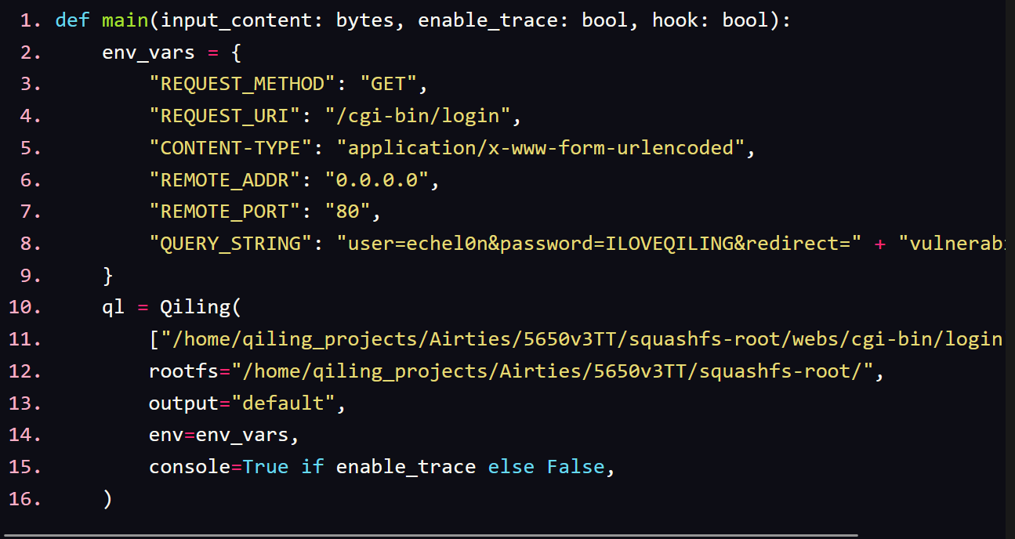
TAS Example: CVE-2015-2797
Writing our custom emulation script

Slide 16
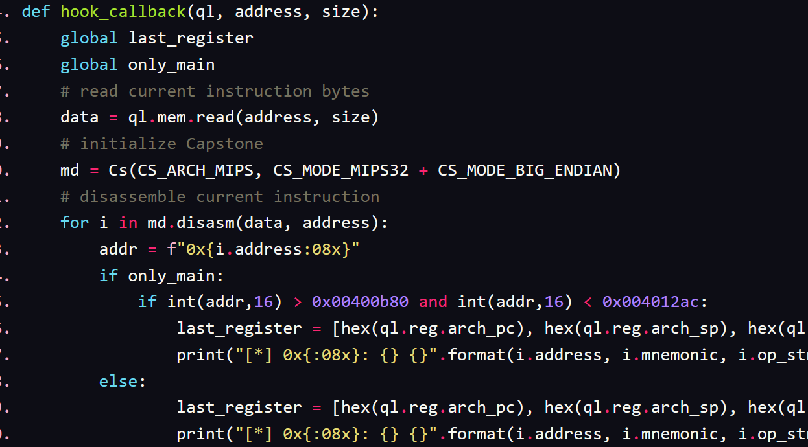
TAS Example: CVE-2015-2797
Writing our custom emulation script

Slide 17
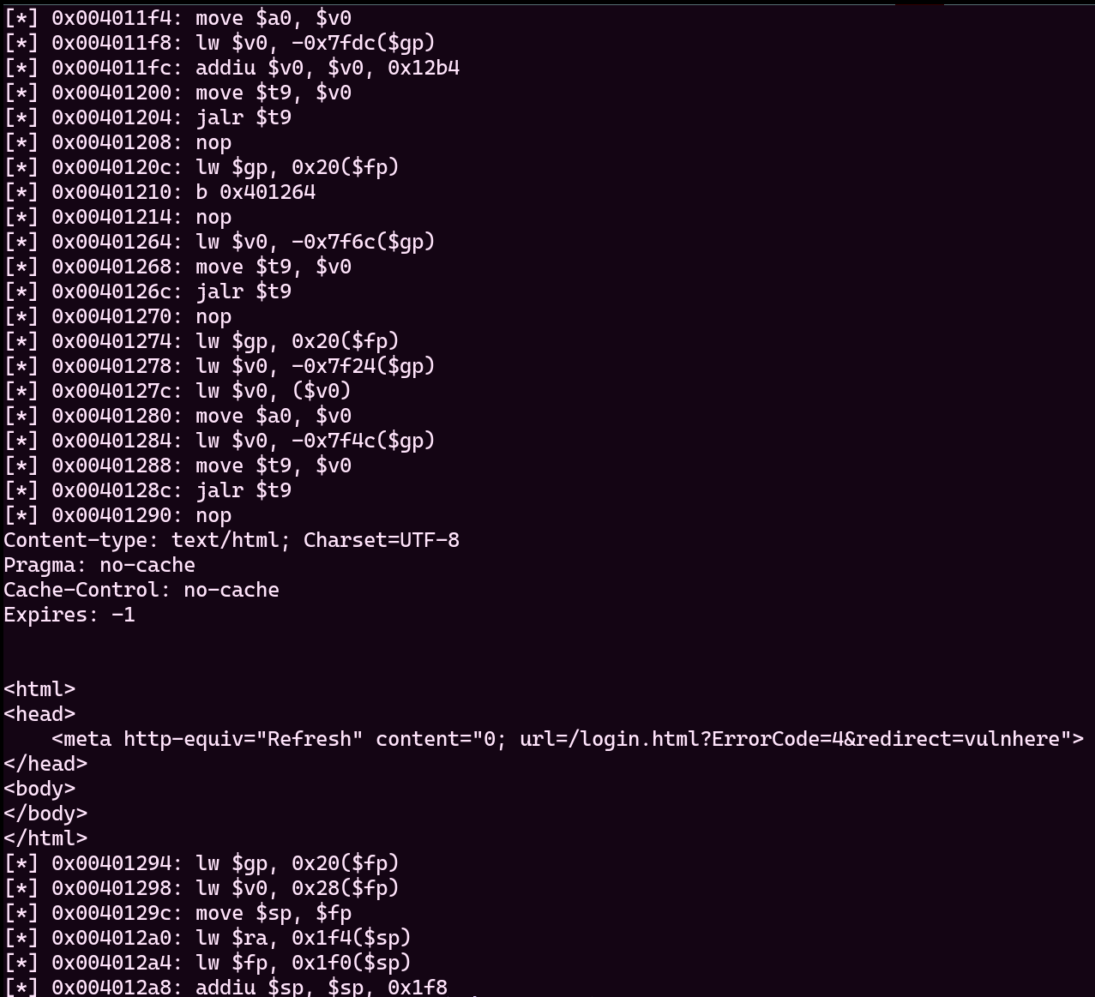
TAS Example: CVE-2015-2797
Writing our custom emulation script

Slide 18
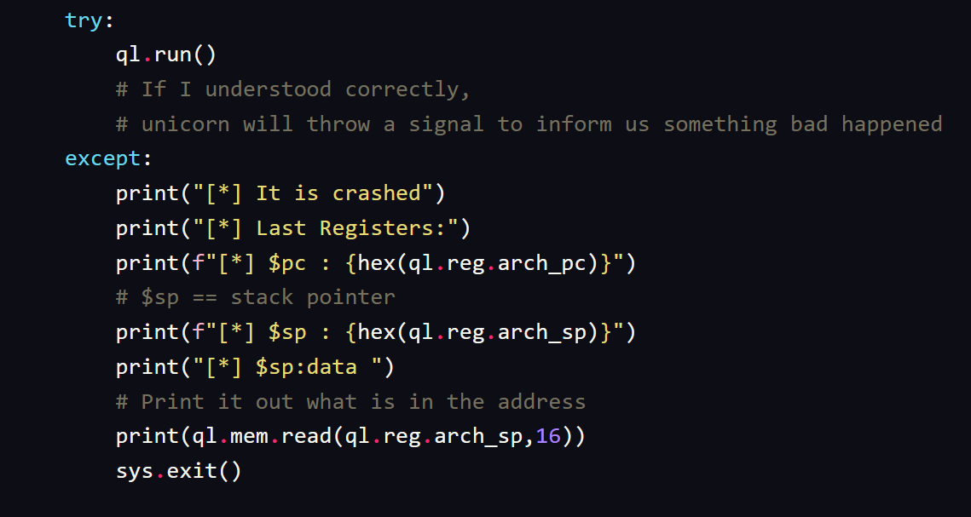
TAS Example: CVE-2015-2797
Writing our custom emulation script

Slide 19
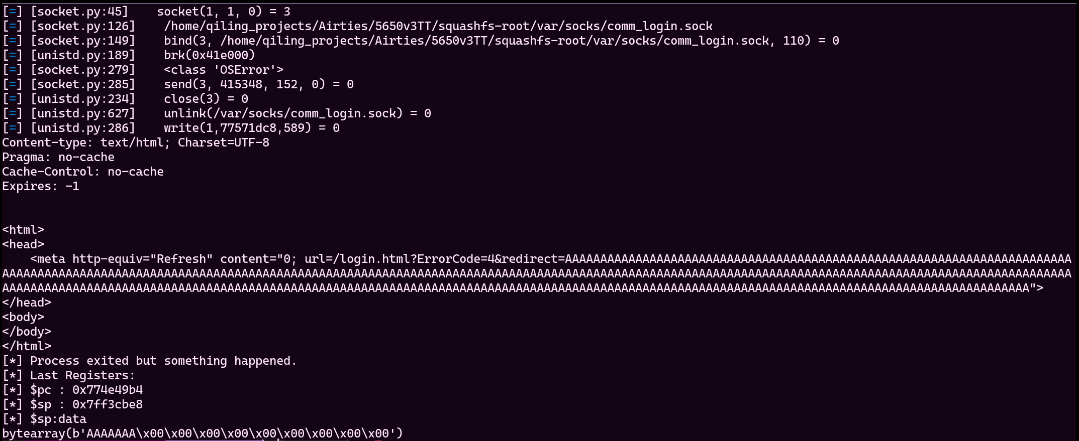
TAS Example: CVE-2015-2797
Writing our custom emulation script

Slide 20
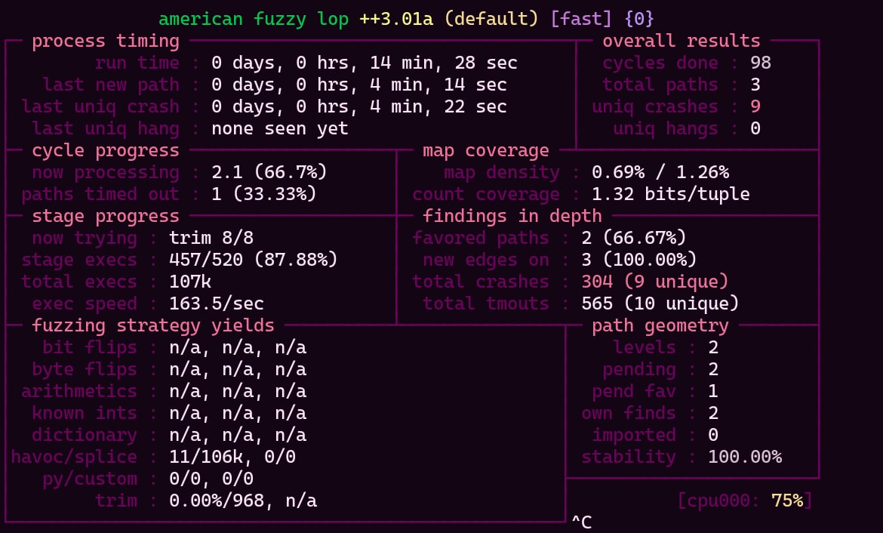
TAS Example: CVE-2015-2797
The big question: Is fuzzing possible?

Slide 21
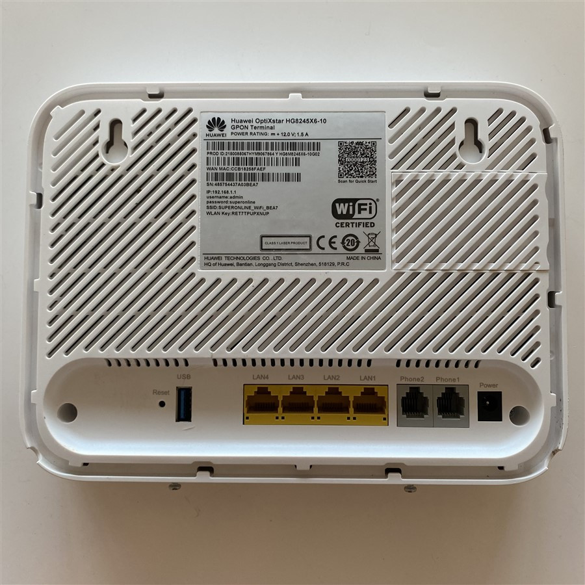
TAS Example 2: Emulating aescrypt2
Huawei HG8245X6 Optical Network Terminal

Slide 22
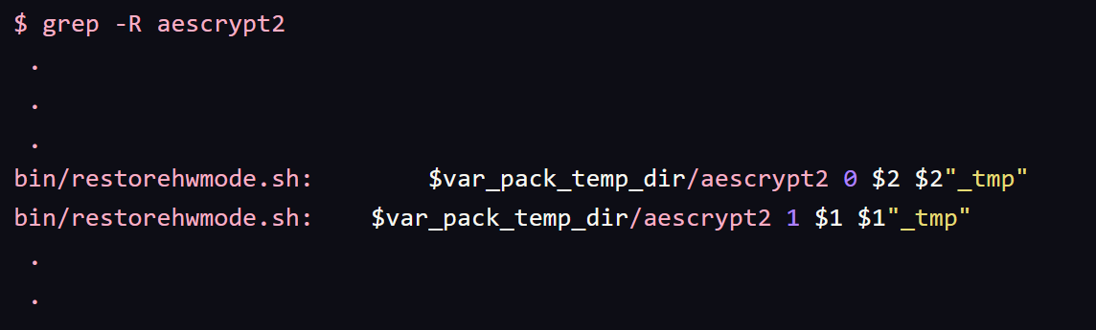
TAS Example 2: Emulating aescrypt2
Huawei HG8245X6 ONT’s configuration XML files are stored encrypted.

Slide 23
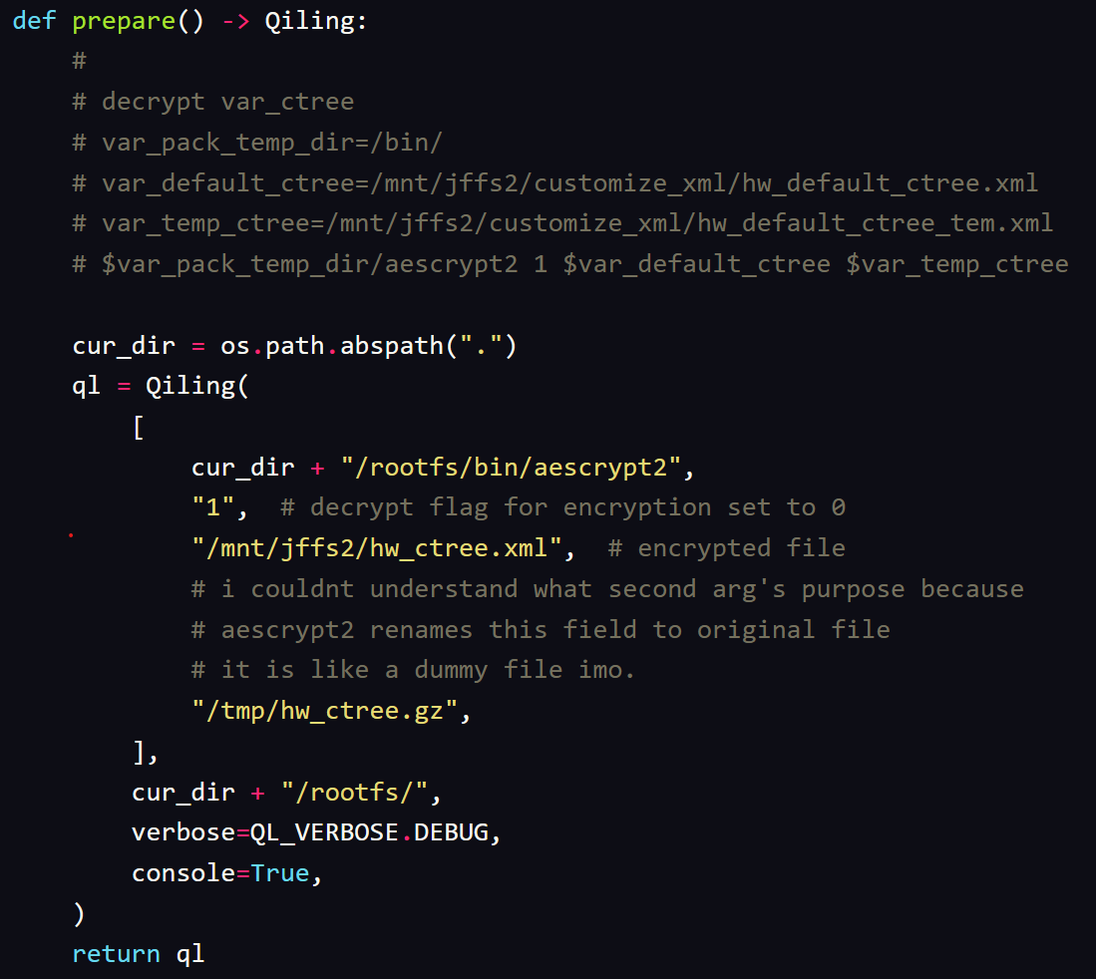
TAS Example 2: Emulating aescrypt2
Emulating aescrypt2 with some adjustments

Slide 24
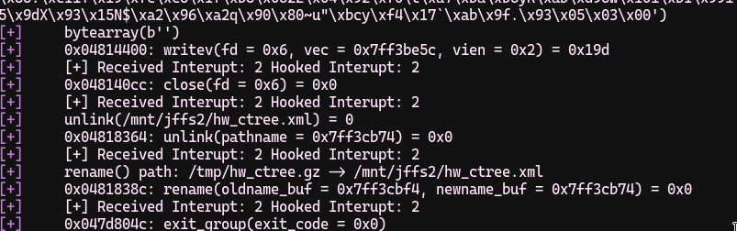
TAS Example 2: Emulating aescrypt2
Emulating aescrypt2 with some adjustments

Slide 25
TAS Example 2: Emulating aescrypt2
Emulating aescrypt2 with some adjustments

Slide 26
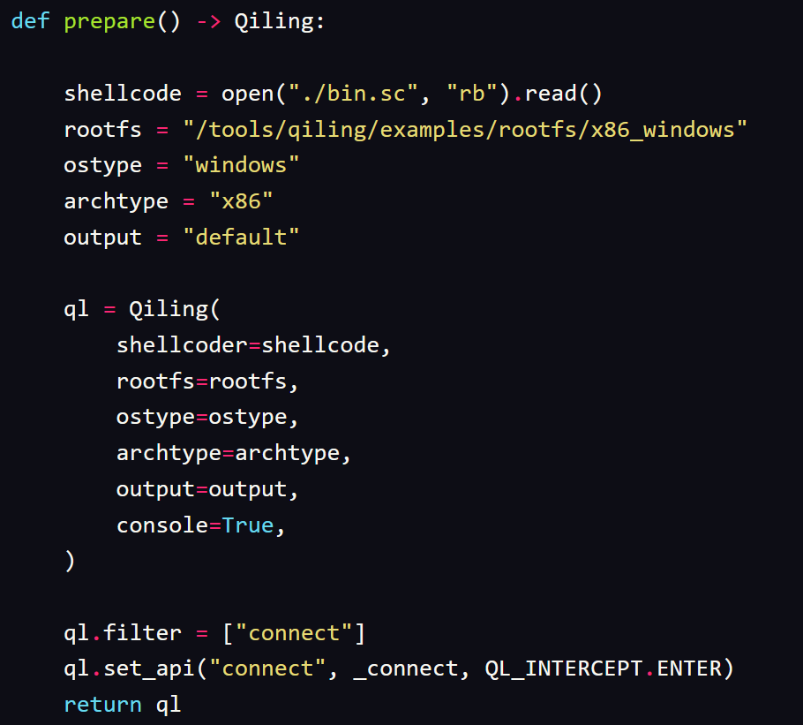
TAS Example 3: msfvenom payload
Instrumentated Dynamic Analysis of a msfvenom payload

Slide 27
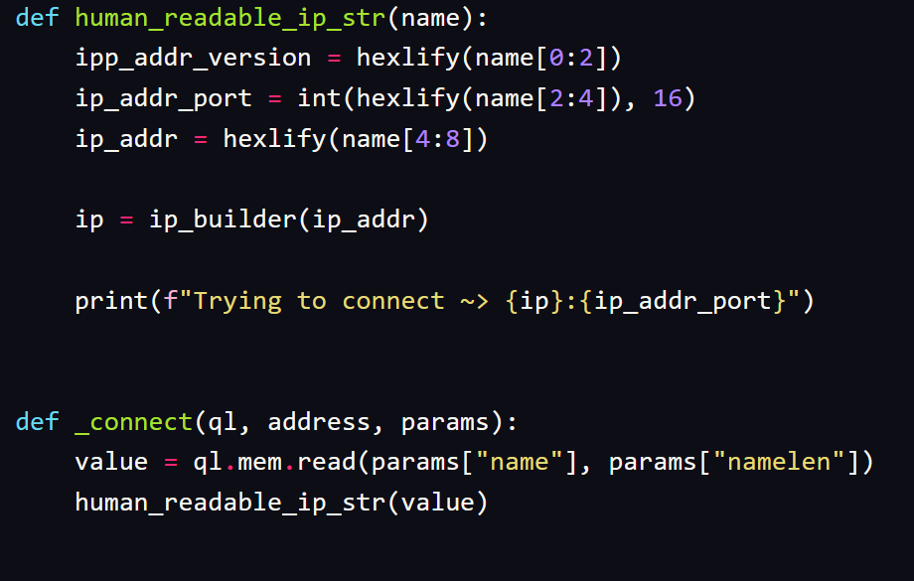
TAS Example 3: msfvenom payload
Instrumentated Dynamic Analysis of a msfvenom payload

Slide 28
TAS Example 3: msfvenom payload
Instrumentated Dynamic Analysis of a msfvenom payload

Slide 29
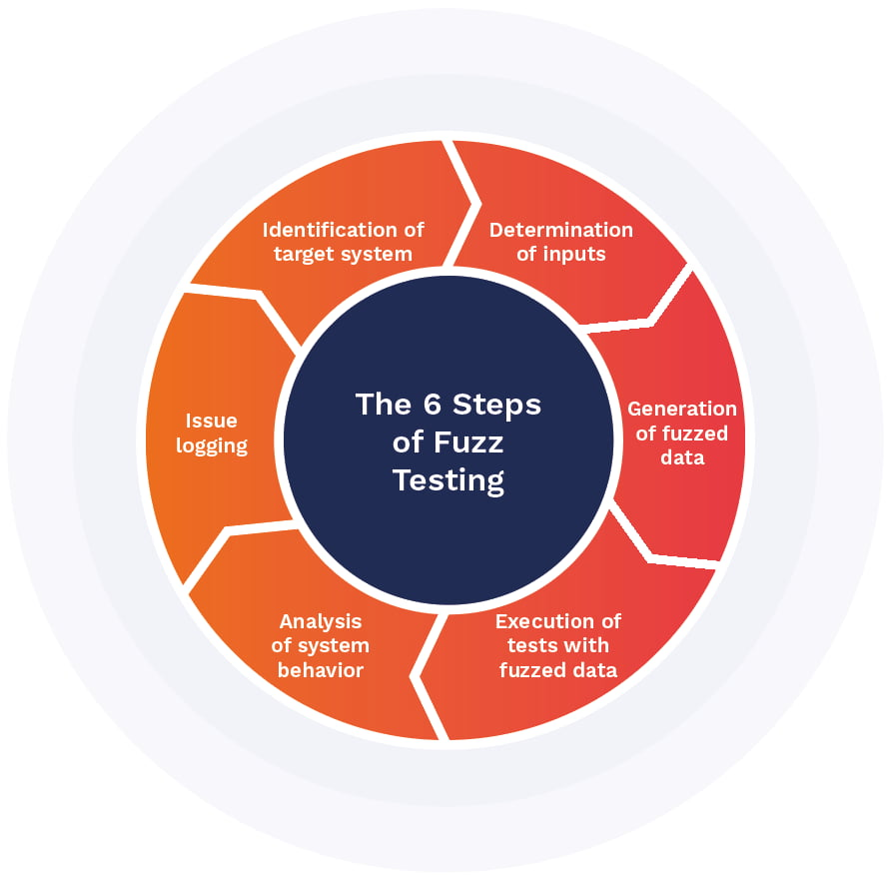
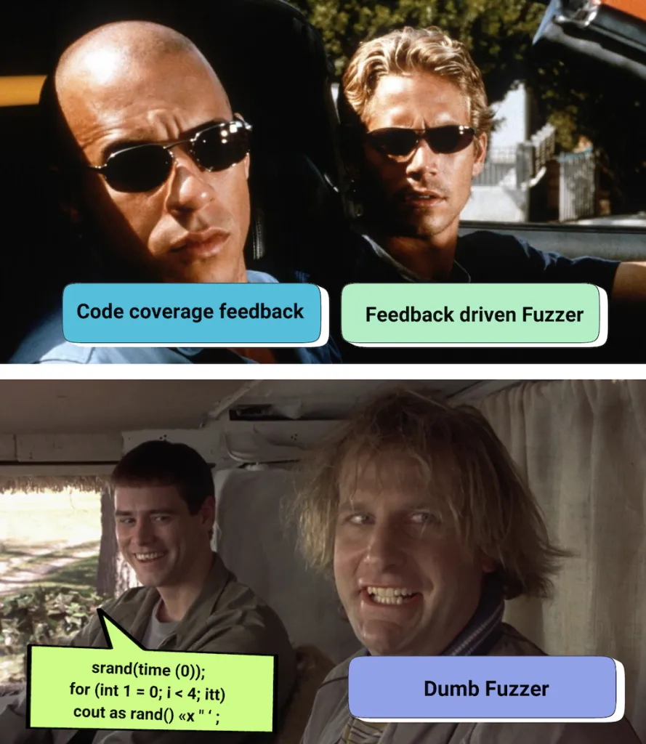
Fuzzing

Slide 30
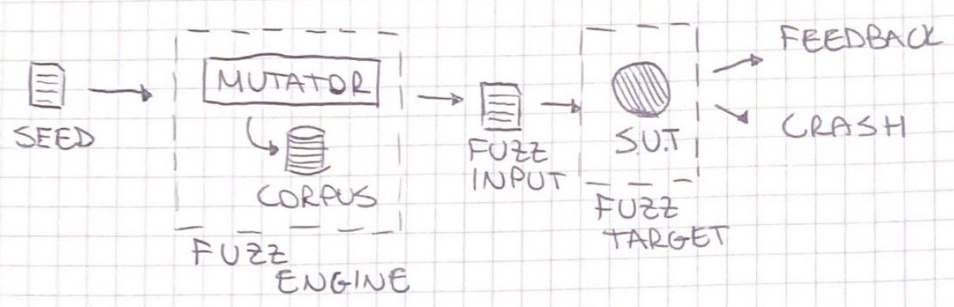
Fuzzing

Slide 31

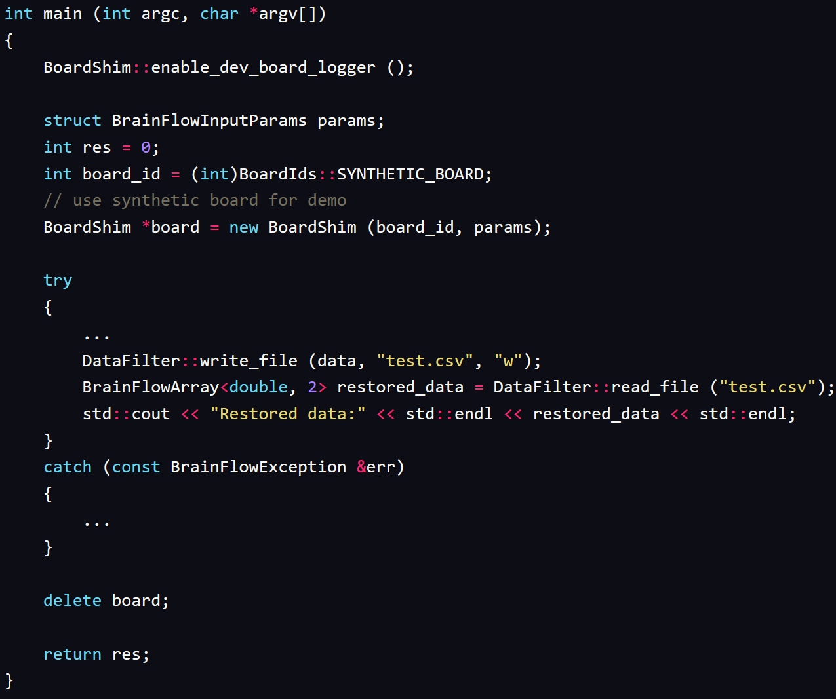
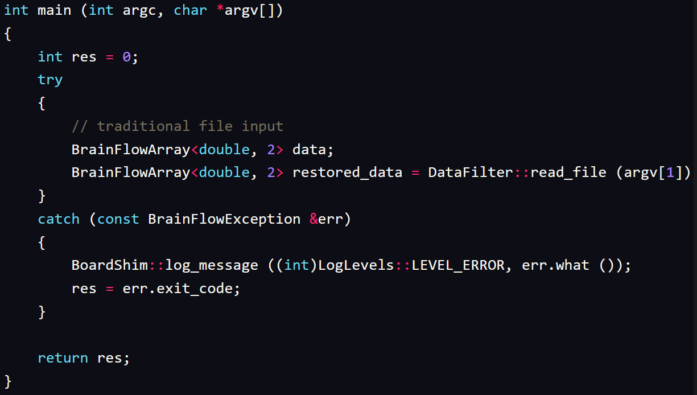
Fuzzing Example: Brainflow
BrainFlow is a library intended to obtain, parse and analyze EEG, EMG, ECG, and other kinds of data from biosensors.
Transfer into this version

Slide 32
Fuzzing Example: Brainflow

Slide 33
Fuzzing Example: Brainflow

Slide 34
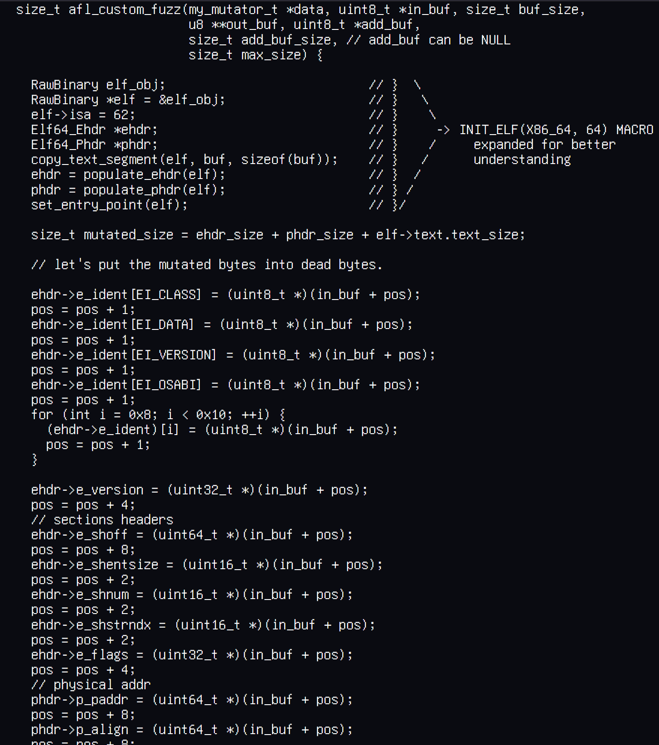
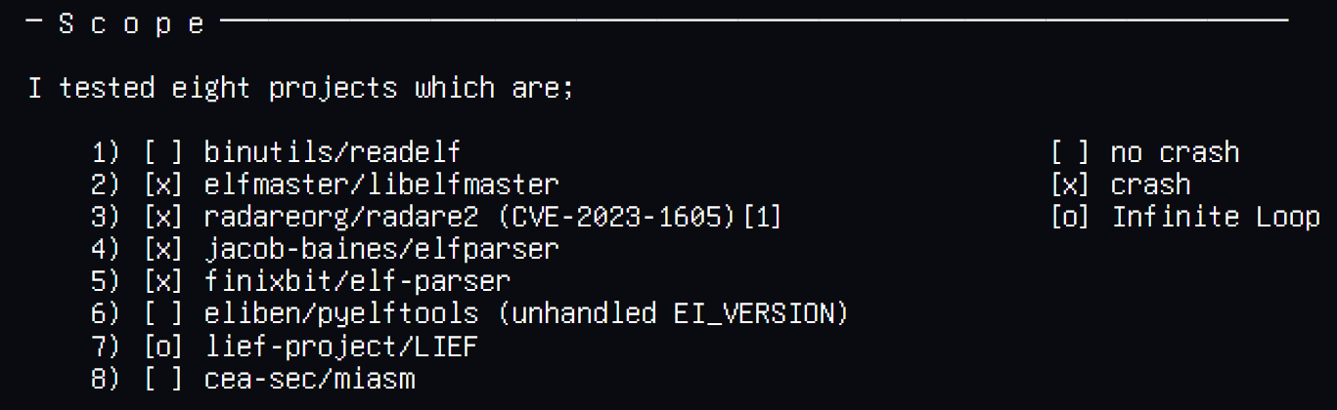
Fuzzing Example: ELF Parsers
Custom mutators help researchers to reach out more edges and code coverage. If your target is expecting more structured input, randomly mutated inputs will not help you to go through into code base.
https://tmpout.sh/3/09.html
https://github.com/echel0nn/golfuzz

Slide 35

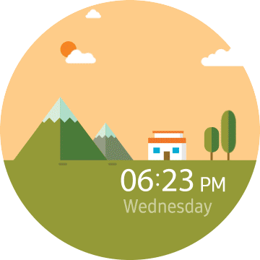
Fuzzing Example: Telegram
This example is a vector based animation renderer library, which is also used in Telegram application.
Structure-Aware Fuzzing is way-to-go strategy choice to fuzz big projects.

Slide 36
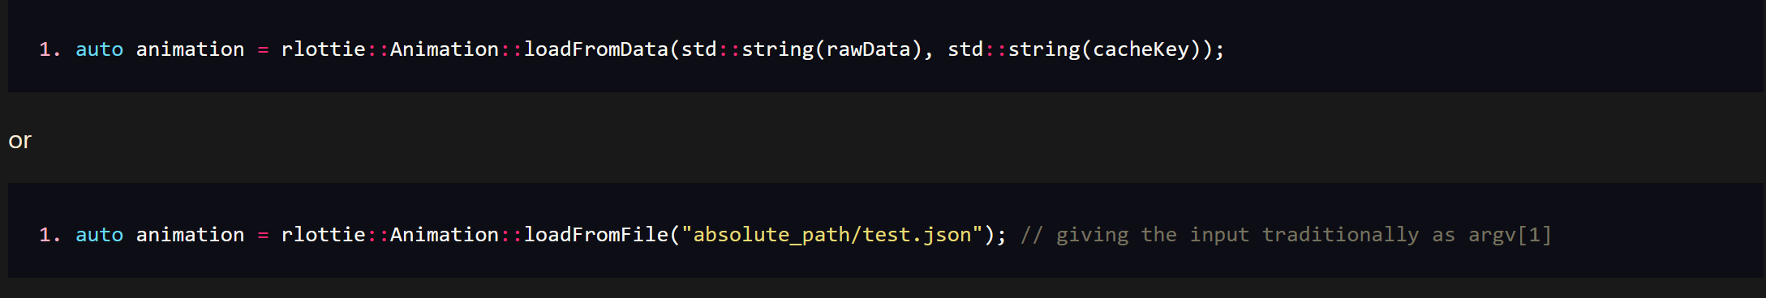
Fuzzing Example: Telegram
Finding the best suitable function

Slide 37
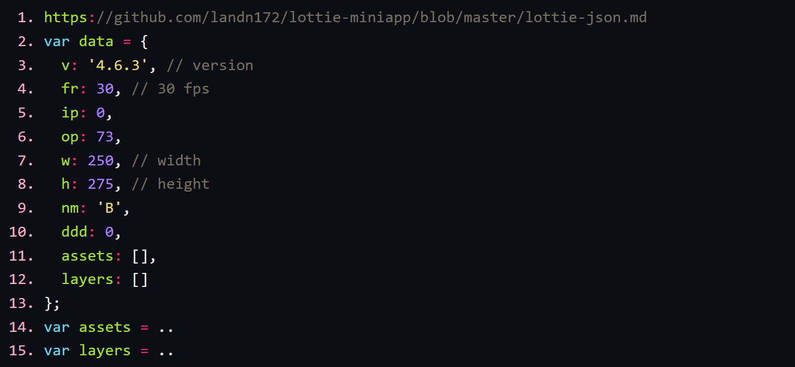
Fuzzing Example: Telegram
Acceptable variables by rlottie library

Slide 38
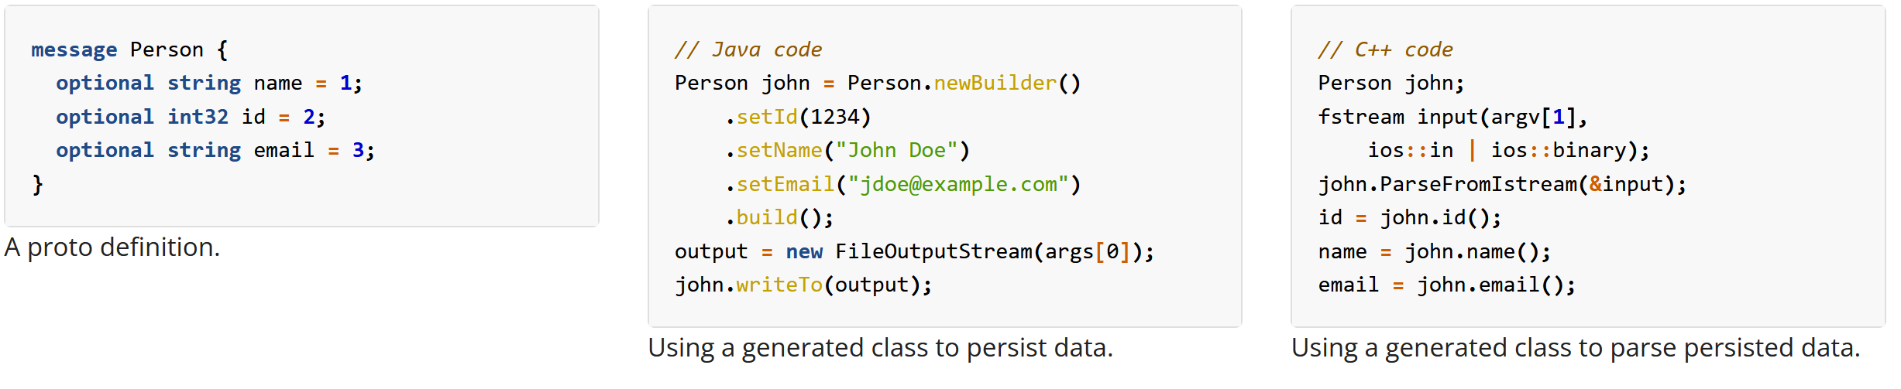
Fuzzing Example: Telegram
What is Protobuf? (Protocol buffers)

Slide 39


Fuzzing Example: Telegram
Let’s get lazy and ask ChatGPT to convert example JSON into protobuf message!
Can you convert this JSON data into protobuf message?

Slide 40

Fuzzing Example: Telegram
Using aflplusplus-libprotobuf-mutator (developer: p1ummer @ github)

Slide 41

Fuzzing Example: Telegram
The example harness that can consume those protobuf mutated inputs

Slide 42



Fuzzing Example: Telegram
Important Note: You are still dependent on your seeds, the mutator is not going to magically expand itself into more functions!

Slide 43

What can we expect in future?
More userspace emulation frameworks for testing
More CI/CD friendly workspace will be available
Exploitation helpers (/w simulation engines and AI?)
Blackbox testing is going to be more like greybox

Slide 44
Resources
All mentioned research is available @ devilinside.me (ELF is @ tmpout.sh Volume III)
Harness examples are in “Projects I Would Like to Fuzz(PILF)” repository (https://github.com/echel0nn/PILF)

Slide 45
Thank you!

